Slide 1
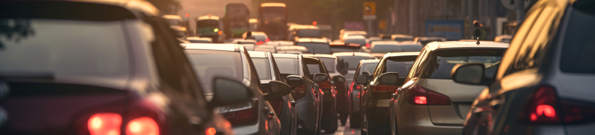
Predicting Traffic Volume

Slide 2
Project Idea Selection
Traffic congestion in urban areas leads to delays, pollution, and economic losses. To tackle this, we developed a predictive model using a Kaggle time-series dataset that includes historical traffic data, weather conditions, and time-related features. Our model aims to provide accurate traffic predictions to enhance traffic management and planning.

Slide 3
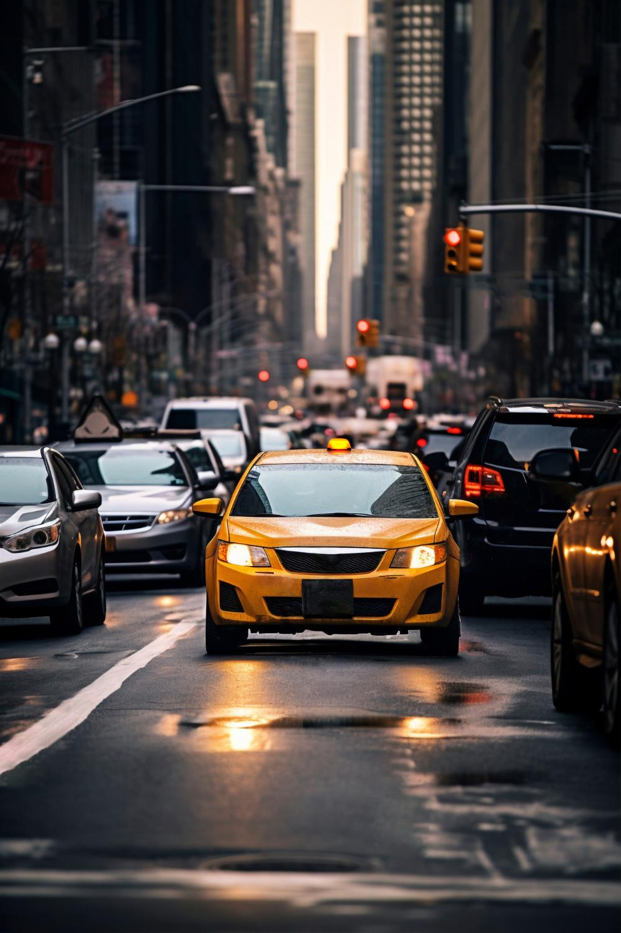

DATABASE

Slide 4
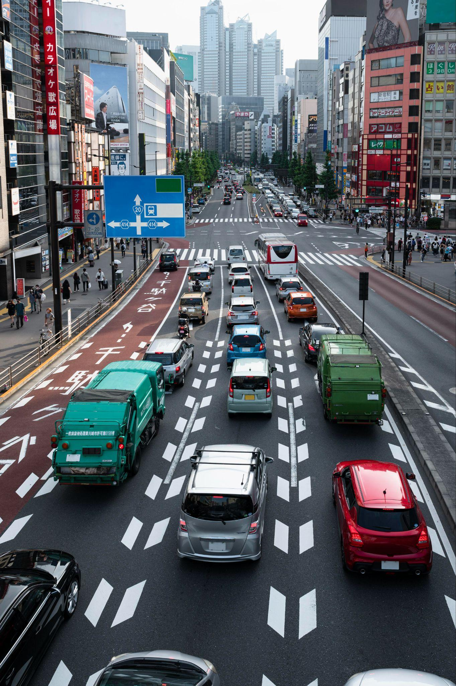
Data Preprocessing
The goal of this step is to divide the time into hour, days and months. can help capture and model the cyclical and seasonal patterns inherent in such data.

Slide 5
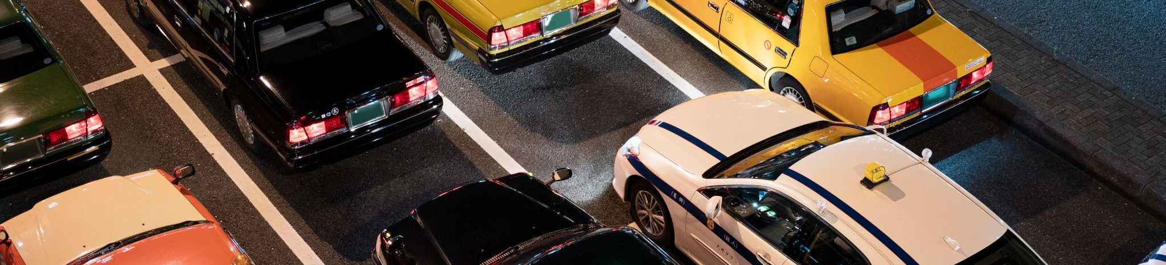
MODELS
01
02
03
RNN (Recurrent Neural Network)
GRU (Gated Recurrent Unit)
LSTM (Long Short-Term Memory)

Slide 6
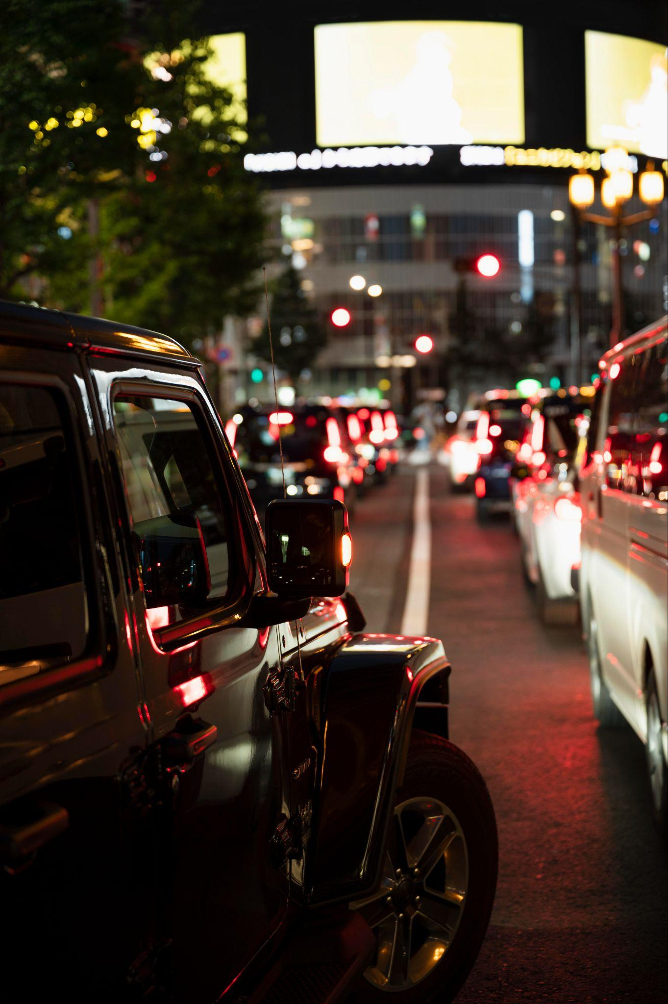
Evaluation
Loss : 0.0109
Val_loss = 0.0131

Slide 7
Deployment

Slide 8
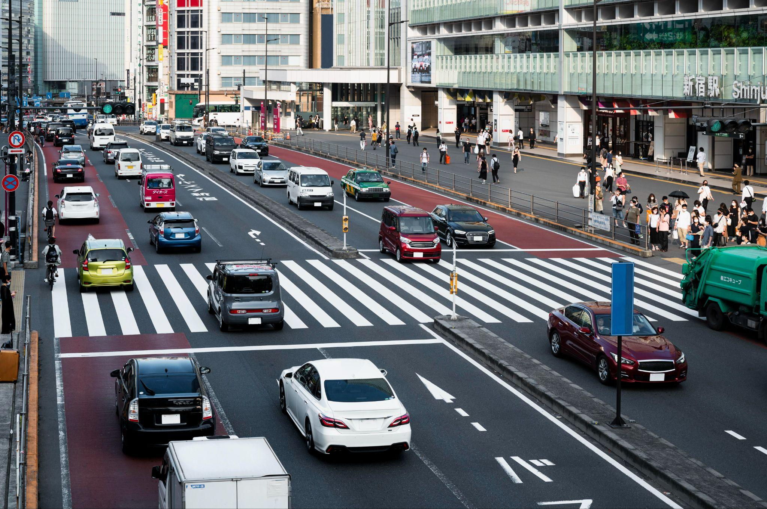
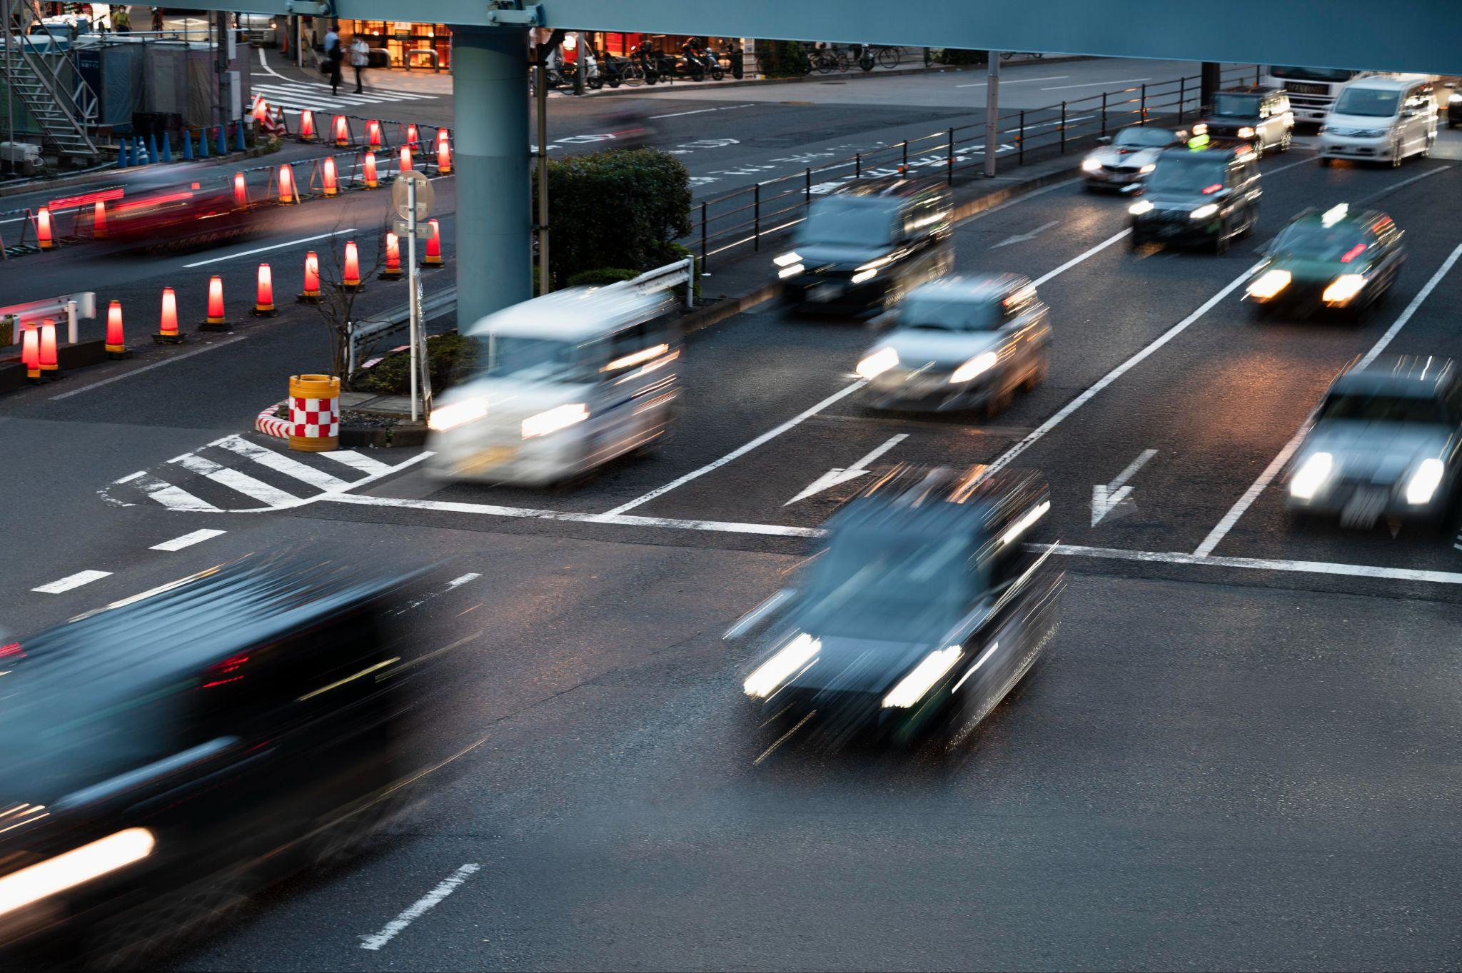
Thank you
Sara Bin Mehaini
Amal Alqahatni
Nora Alshahrani

